Slide 1
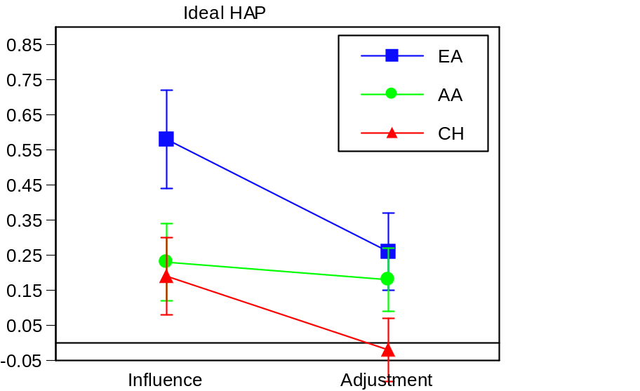
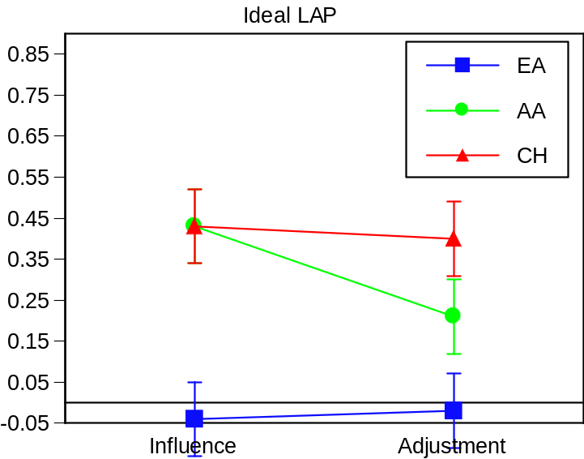
Open Ended Responses To Influence and Adjustment Scenarios (Pilot)

